Slide 1

I-Scroll

Slide 2

INTRODUCTION
Computer technology has tremendously grown over the past decade and has become a necessary part of everyday live. Now days computers are used in almost every field . To use this powerful machine efficiently , we have to interact with it and here comes the new buzzword –
Human Computer Interface (HCI)

Slide 3
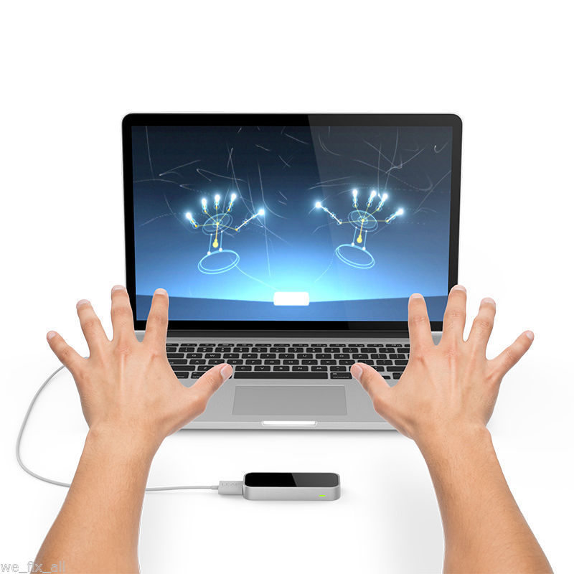
Problem Statement :
Human Computer Interface
(HCI)
Human Computer Interface or HCI is a system comprising of hardware and software that helps in communication and exchange of information between the user (human operator) and the computer.
The primary computer accessory for Human Computer Interaction (HCI) is the mouse. The mouse is not suitable for HCI in some real life situations, such as with Human Robot Interaction (HRI). The most natural and intuitive technique for HCI, that is a viable replacement for the computer mouse is with the use of hand gestures.

Slide 4
PROPOSED SOLUTION
In this project, we have implemented a simple Arduino based hand gesture control where you can control few functions of your web browser like switching between tabs, scrolling up and down in web pages, shift between tasks (applications), play or pause a video and increase or decrease the volume (in VLC Player) and many more functionalities with the help of hand gestures.
PURPOSE OF OUR PROJECT ?
The purpose of our project is to provide any easy interface between computers and humans. We wish to make a windows based application for live motion gesture recognition using ultrasonic sensor and pyautogui library of python.

Slide 5
PRINCIPLE BEHIND THE PROJECT
The principle behind the Arduino based Hand Gesture Control of Computer is actually very simple. All you have to do is use two Ultrasonic Sensors with Arduino, place your hand in front of the Ultrasonic Sensor and calculate the distance between the hand and the sensor. Using this information, relevant actions can be performed.
The position of the Ultrasonic Sensors is very important. Place the two Ultrasonic Sensors on the top of a laptop screen at either end. The distance information from Arduino is collected by a Python Program and a special library called PyAutoGUI will convert that data into keyboard click actions.

Slide 6
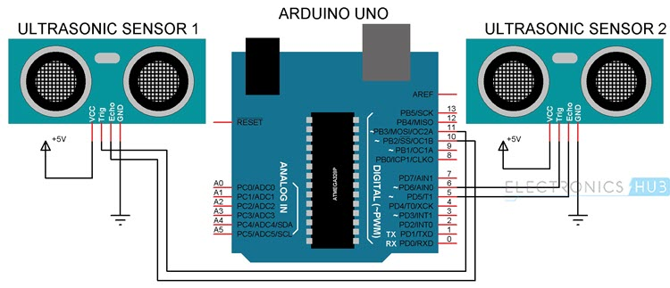
CIRCUIT DIAGRAM
The circuit diagram of Arduino part of the project is shown in the following image. It consists of an Arduino UNO board and two Ultrasonic Sensors and you can power up all these components from the laptop’s USB Port.

Slide 7



OUR PRODUCT FUNCTIONS
Switching between different tasks
Controlling Multimedia
Scrolling
Webpages

Slide 8
SCOPE AND BENEFITS
The most important advantage of the usage of hand gestures based input modes is that user can interact with the application from a distance without any physical interaction with the keyboard and mouse.
It will reduce the use of some prominent peripheral devices such as mouse.
Provide easy interface to interact with the computer.
Provide easiness to the user for changing slides at the time of power-point presentations.
Gesture recognition can be used to provide more attractive gaming environment to truly immerse players in the game world like never before.
Regardless of the brightness level in user’s operating environment, the program can always detect user’s hands.

Slide 9
SPECIFIC REQUIREMENTS
Hardware -
Arduino UNO
Ultrasonic Sensors
USB Cable (for Arduino)
Few Connecting Wires
A Laptop with internet connection
Software -
Operating system (windows , linux)
Python IDE with pyautogui module

Slide 10
Thank You

